Slide 1
Welcome

Slide 2
Hospital Management System Team Name : Team_Tetra
Submitted From
Ayesha Rahman (23101166)
Mariam Akhter Jahan (23101167)
Proma Das krity (23101169)
Shah Iqra (23101180)
Section : D1
Submitted from
Alif Ruslan
Lecturer
University of asia pacific

Slide 3
Introduction
A Hospital Management Database System designed to streamline hospital operations and enhance patient care through efficient, structured data management.
Project Overview
The Necessity of the System
Unique Characteristics
Intended Users of the System
Academic and Research Use
Benefits for Humanitarian and Public Health Services
Long-Term Benefits for the Future

Slide 4
Table overview
There are 12 tables in this database
Department – Info on medical departments
Doctor – Doctor roles and details
Staff – Staff identification data
Patient – Patient records and history
Appointment – Patient-doctor scheduling
LabTest – Medical test records
Surgery – Surgical procedure tracking
Ward – Ward-based patient info
MedicalStore – Medicine and stock details
Vaccination – Patient immunization data
Billing – Service charges and payments
HospitalAsset – Equipment and asset tracking

Slide 5
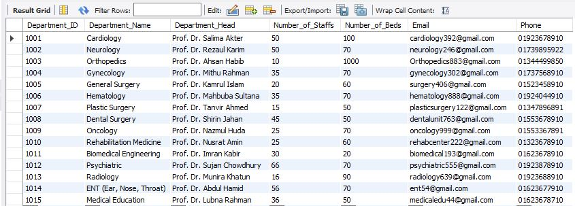
Department table
SELECT * FROM Department;

Slide 6


Doctor table
SELECT * FROM Doctor WHERE Doctor_ID = 100136;
SET SQL_SAFE_UPDATES=0;
UPDATE Doctor
SET Salary = Salary - 4500
WHERE Doctor_ID = 100140;
SELECT * FROM Doctor WHERE Doctor_ID = 100140;

Slide 7
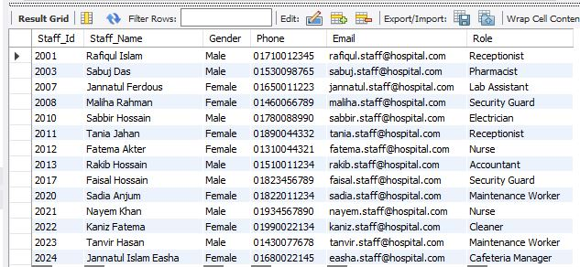
Staff table
SELECT * FROM Staff WHERE Staff_Name like '_a%';

Slide 8

Patient table
SELECT Blood_Group, COUNT(*) AS Female_AB_Pos_Count FROM Patient
WHERE Blood_Group = 'AB+'
AND Gender = 'Female'
AND Date_of_Birth > '1980-01-01'
GROUP BY Blood_Group;

Slide 9
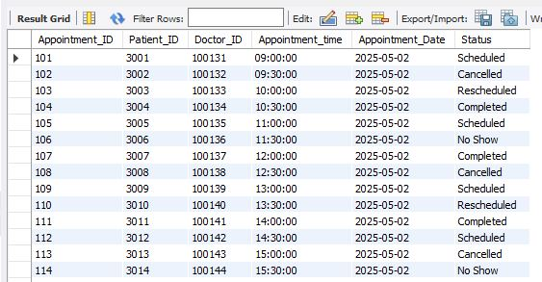
SELECT * FROM Appointment WHERE Appointment_Date = ( SELECT MIN(Appointment_Date)
FROM Appointment );
APPOINTMENT TABLE

Slide 10
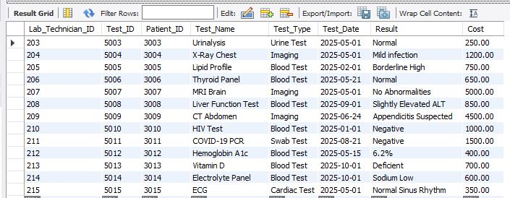
Lab test table
SELECT *FROM LabTest
WHERE Test_Name NOT LIKE '%Blood%';

Slide 11
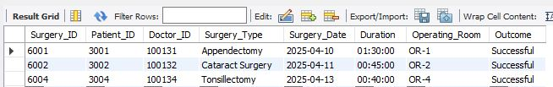
Surgery table
SELECT * FROM Surgery
WHERE Outcome = 'Successful'
LIMIT 3;

Slide 12
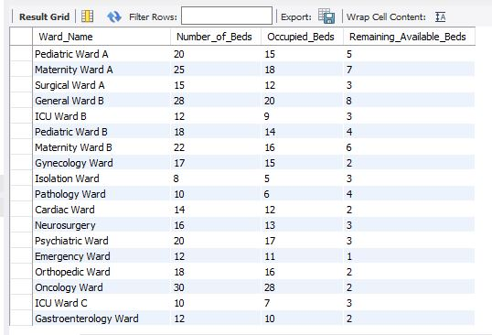
Ward table
SELECT Ward_Name, Number_of_Beds, Occupied_Beds,
(Number_of_Beds - Occupied_Beds) AS Remaining_Available_Beds
FROM Ward;

Slide 13
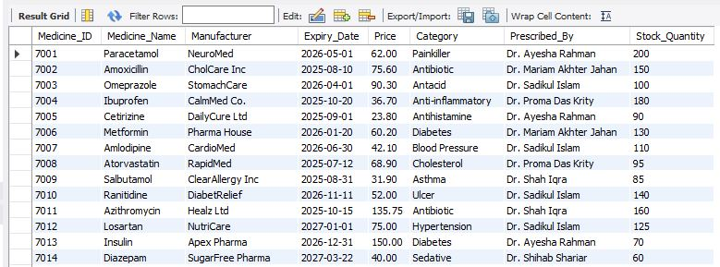
MEDICINESTORE Table
ALTER TABLE MedicineStore
RENAME TO Pharmacy;
ALTER TABLE Pharmacy
RENAME COLUMN Suggested_By TO Prescribed_By;

Slide 14
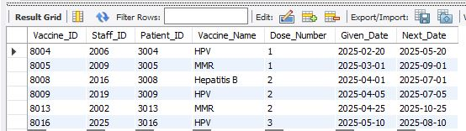
Vaccination table
SELECT * FROM Vaccination
WHERE Vaccine_Name IN ('Hepatitis B', 'HPV', 'MMR')
AND Next_Date >= CURRENT_DATE;

Slide 15

Billing Table
SELECT COUNT(Patient_ID) FROM Billing WHERE Total_Amount>1000 AND Total_Amount<2100;

Slide 16
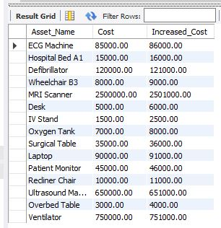
Hospitalasset table
SELECT Asset_Name, Cost, Cost + 1000 AS Increased_Cost FROM HospitalAsset;

Slide 17
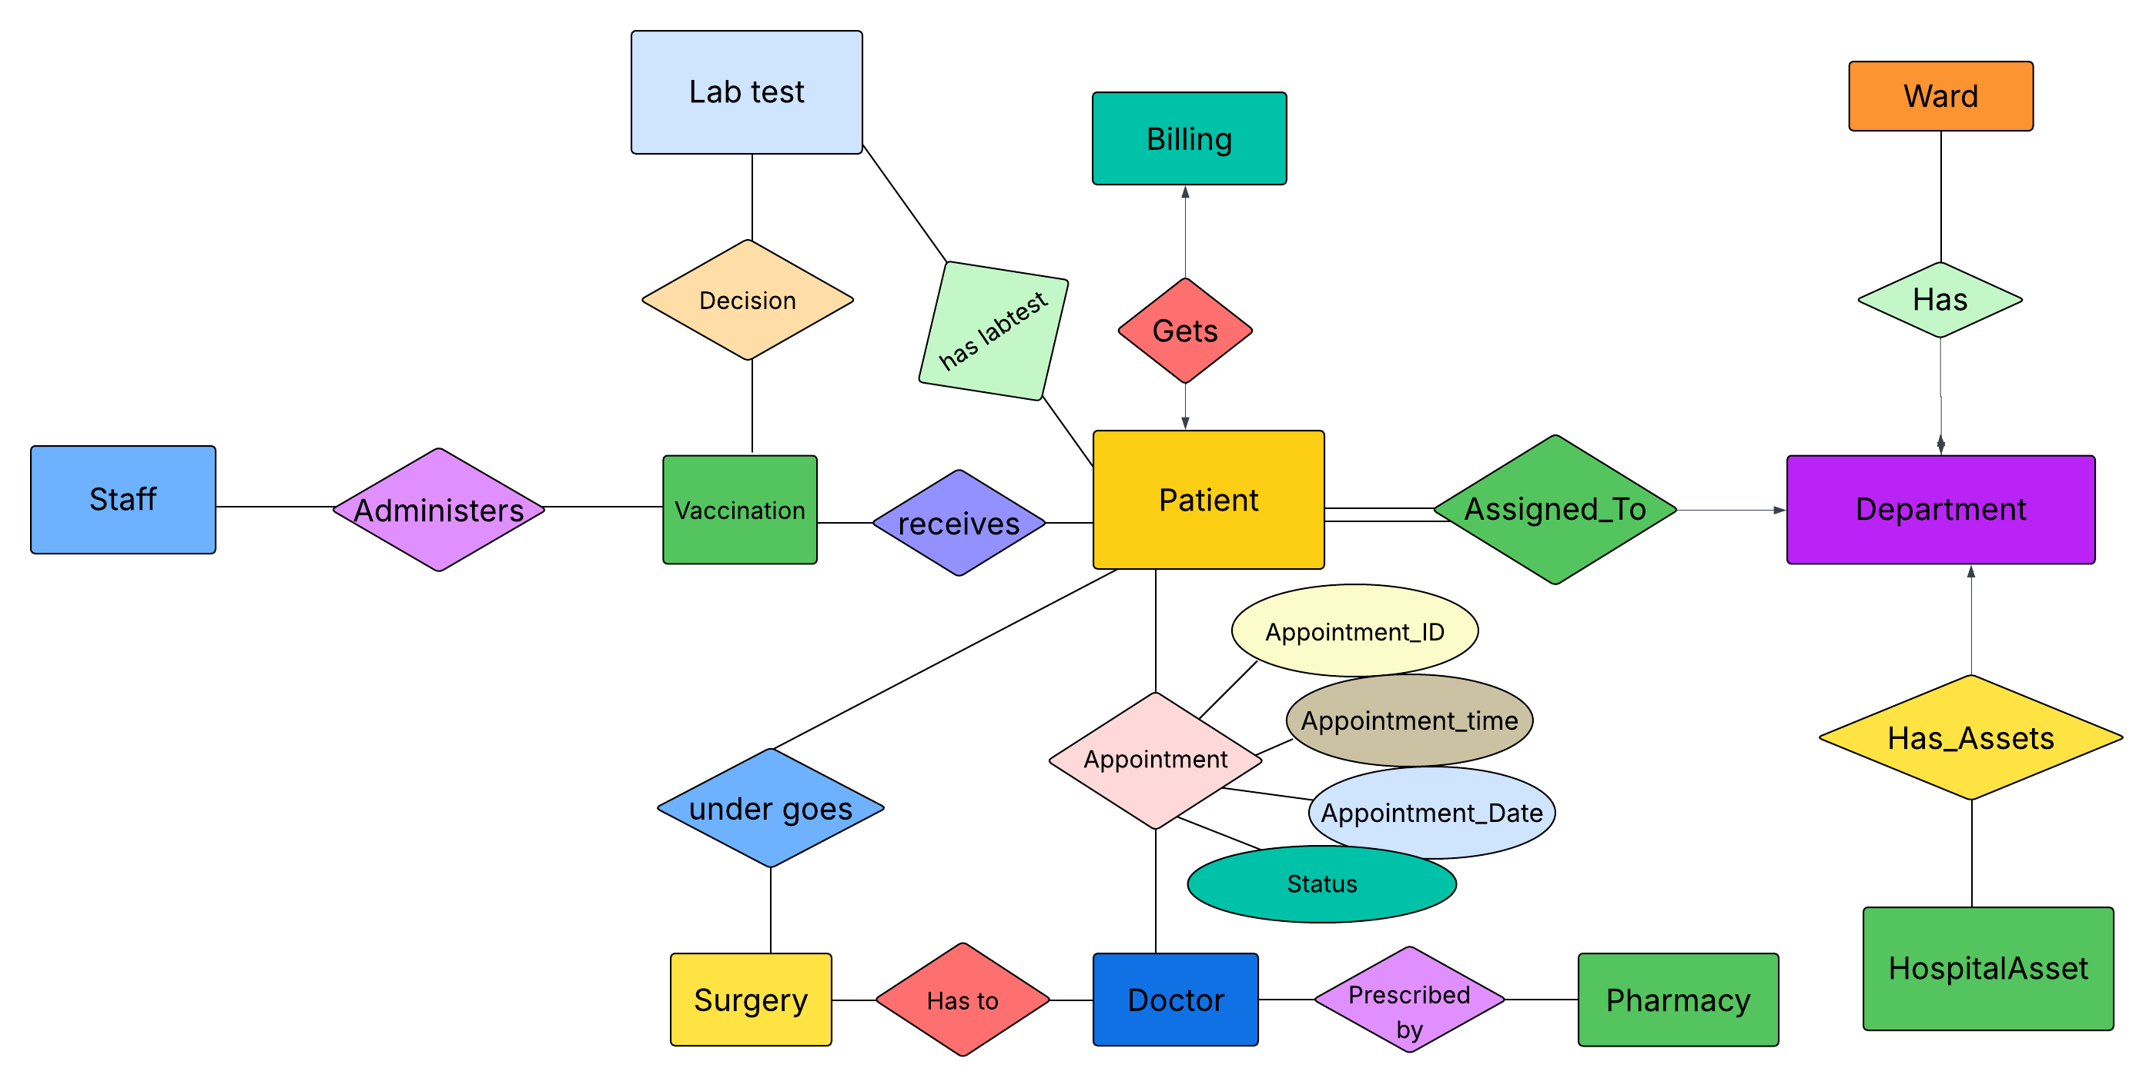

Slide 18
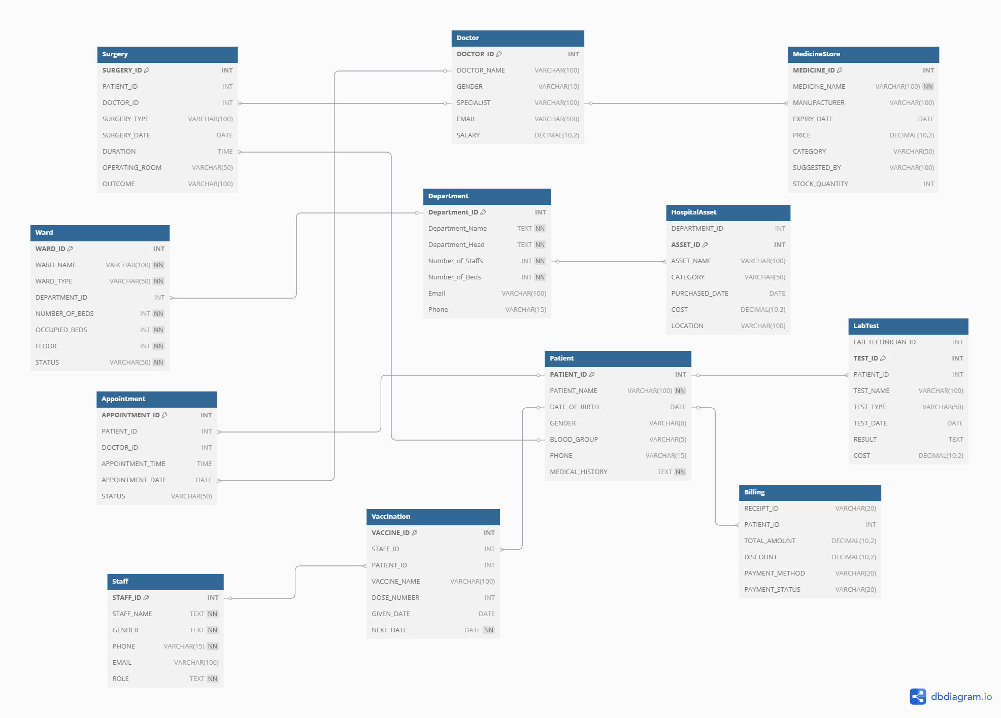

Slide 19
conclusion
This hospital management system project using sql helped us understand how to organize and manage hospital data properly. We created different tables for doctors, patients, staff, billing, appointments, and more. By using sql queries, we learned how to insert, update, delete, and search information easily. This project showed us how databases help hospitals run smoothly by keeping all records safe, accurate, and well-connected.

Slide 20
THANK you

